Slide 1


Media information online 2024
Pigeon-marketplace.com — online-portal for the international pigeon sport
Portal manager
Peter Kocks
Hugo-Rasch Str. 97
46047 Oberhausen Germany
Fon +49 (0) 178 453 7775
E-Mail peter.kocks@brieftauben-markt.de
Technology and support
FRIESE MEDIA GmbH, Center Cologne
Elke Klinger Friesenplatz 17
50672 Cologne Germany
Fon +49 (0) 221 93 53 19 0
E-Mail ek@friesemedia.de

Slide 2

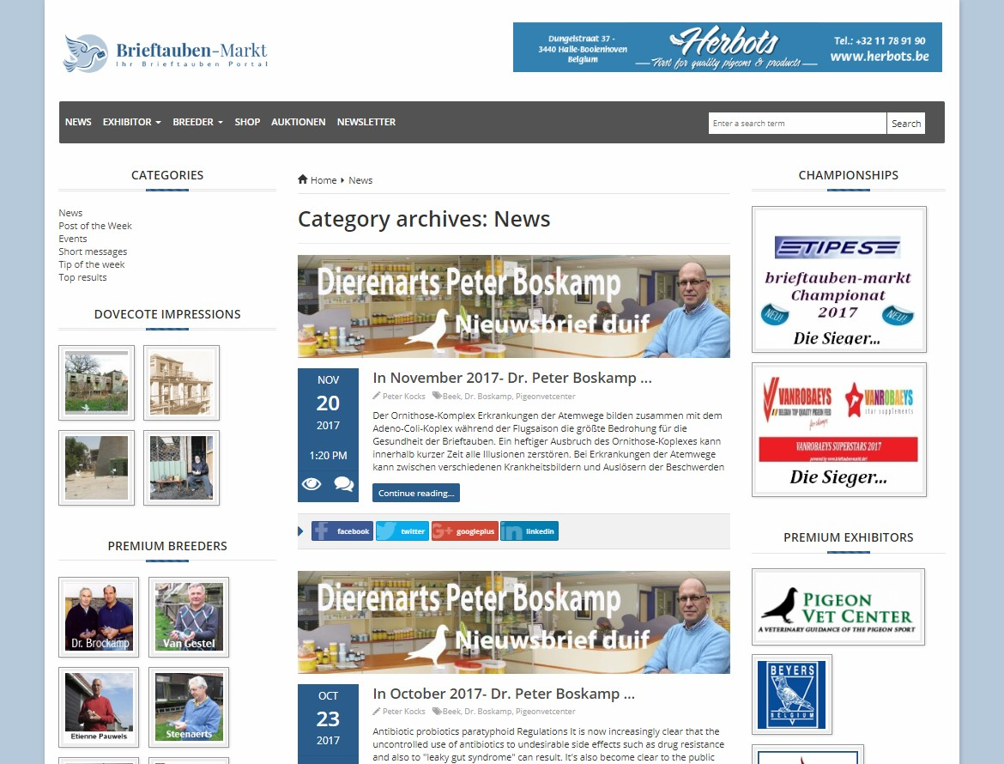
Characteristic of the portal
Present yourself on our online portal worldwide, 24 hours a day, 365 days!
Companies and pigeon fanciers have been presenting themselves to visitors on the internet portal for 10 years with online information on their companies, products, services, lofts, racing pigeons, flight performance and more ...
They provide extensive information, links, pictures, videos.
The exhibitors and visitors receive added value in the form of an online newspaper, newsletters, online shops, online auctions.
575.000
visitors since 2007
+30%
compared to 2016
61 nations
and 8 languages
80
newsletter per year
300.000
newsletter recipients
P I G E O N - M A R K E T P L A C E . C O M

Slide 3

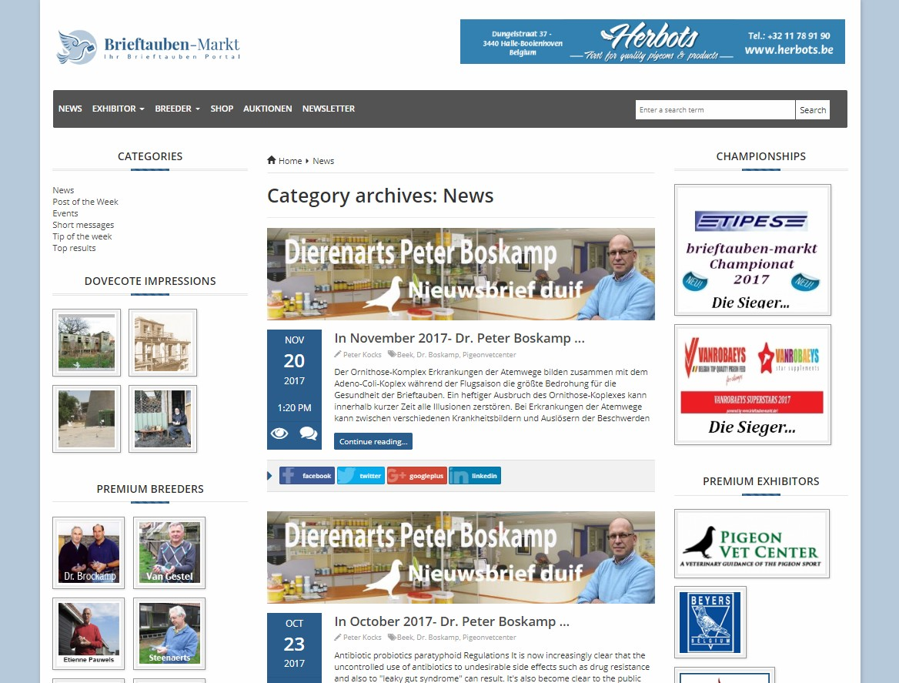
Pigeon portal at a glance
1
Newsletter
Newsletter to your target audience with your messages
5
Pigeon Lofts
Impressions of the lofts of international pigeon fanciers
2
3 1
2
Banner Advertising
Place your banner in the header of the portal on each page
6
Exhibitor premium bar
Your company logo in the exhibitor premium bar as well as the advertising campaigns of pigeon-marketplace.de
4
5
8
3 Auctions
Current auctions of pigeon fanciers
Exhibitors, products, services
7
Pigeon fanciers
Fanciers, lofts, pigeons
7
6
4
Advertisement
Placing an ad in the portal newspaper and the newsletter
8
Current informations
Current news, post of the week, events, short news, tip of the week, top results
P I G E O N - M A R K E T P L A C E . C O M

Slide 4


Pigeon portal at a glance
Your benefits
What does the portal offer
The exhibitor stand
The pigeon fanciers stand
365 days a year, 24 hours a day
exhibitor stand for companies and fanciers
presentation of the company
presentation of the products, services
contact persons
events, special actions
presentation of the fancier
Presentation of the loft, pigeons
contact information, contact persons
global presence
multiple languages
high-quality contacts
products, services
lofts, pigeons
events, special actions, informations, links
newsletter, auctions, online shops
high access frequencies
updating your exhibition presence - online
newsletter to your target audience with your messages
without any restrictions …
informations, links
optional with exhibition films
reports
Top results
online marketing
search engine optimization
and much more…
P I G E O N - M A R K E T P L A C E . C O M

Slide 5
Exhibitor packages for companies
Basic
Professional
Premium
Online stand with your company logo
Your company logo in the premium exhibitor bar
Your company logo in the online exhibitor list and the advertising campaigns of pigeon-marketplace.com
Presentation of your company, your products, services, appointments, contacts and more …
Option to change your details (per year)
four times
permanent
once at the beginning of the exhibition
Editorial support of your company in the portal newspaper by us (per year)
four times
permanent
Additional distribution of your news about the newsletters
once
four times
permanent
50€**
100€**
150€**

Slide 6
Advertising packages for companies
Placement of a banner in the header area of the portal on every page | Banner | Advertisement | Banner+ Advertisement
Banner in rotation
Link on your own website (if available)
Fullsize Banner (600 × 70 px)
Placing an ad in the portal newspaper and the next newsletter
Duration by arrangement
Link on your own website or online-shop
Ad format by arrangement
Fees per month | 30€ | 30€ | 55€
Fees per year | 360€ | 360€ | 660€
 |  |  | save more than 8%
P I G E O N - M A R K E T P L A C E . C O M

Slide 7
Packages for fanciers
Basic
Premium
Online exhibition stand with your logo
Your logo in the online exhibitor list of pigeon-marketplace
Your logo in the fancier premium bar and the advertising campaigns Presentation of your loft with contact person
and contact details and presentation of your pigeons.
Publication of your flight results in the portal newspaper by us.
Editorial presentation and support of your fanciers stand in the portal newspaper by us additional distribution of your news
via the newsletter (per year)
Fees per month
once at the beginning of the exhibition
permanent
once
permanent
20€
40€
P I G E O N - M A R K E T P L A C E . C O M

